Slide 1

Hackathon 2024 Resume Renegades
Shelby Martin
Amudala Olawore
Isha Goyal
Ekenechukwu Nwannunu
Geanie Asante

Slide 2

Problem Statement
In the current recruitment landscape within our organization, recruiters are experiencing a substantial bottleneck in identifying and shortlisting the ideal candidates for various job openings. Despite having access to the Workday portal, which allows for the exploration of job vacancies using basic filters like location and role, our recruiters are constrained by the portal's limited search capabilities.
This limitation significantly impedes our ability to match the vast array of resumes received with the specific requirements detailed in job descriptions, especially for roles requiring unique skill sets or specialized experience. The absence of advanced filtering options—such as filtering by specific skills, years of experience, educational qualifications, or industry-specific certifications—restricts our recruiters' efficiency and effectiveness.
This challenge not only extends the time-to-hire but also affects the quality of talent acquisition, thereby impacting our organization's overall performance and growth potential. To overcome this critical hurdle, there is an urgent need for an enhanced tool or feature within the Workday portal that supports advanced search criteria, enabling both internal and external recruitment efforts to be more precise, efficient, and aligned with our strategic hiring objectives.

Slide 3

Objective
In this challenge, we will be building a system which can use existing resumes and Job Descriptions (JD) from Workday.
The system can extract keywords such as experience, location, and key skills to help automate the research process for job seekers and recruiters. AI can assist in this process by understanding and interpreting the content, facilitating seamless communication between the user and the system. Implementing machine learning models and can enhance the system’s ability to identify relevant matches by learning past interactions and feedback.

Slide 4

The Process
Step 1: Setting up and Preparing Data
1. Create a new Project
2. Data Hygiene and Preparation
a. Format your data: Ensure that your resumes and job descriptions are in a consistent format, ideally JSON or plain text for easier processing.
3. Upload Data: Create a knowledge base where job descriptions, and resumes are stored and uploaded.

Slide 5

The Process
Step 2: Developing a Matching Mechanism
Design your matching criteria: Use the keywords needed for matching, such as skills, experience level, location, role and education.
Use the deployed models: Utilize your models to analyze resumes and job descriptions, extracting and comparing relevant keywords.

Slide 6

The Process
Step 3: Creating Matching Parameters
Define Matching Criteria
Choose an Approach
Implement the System
Testing and Integration
Iterate
Integration
Additional Features
Users can upload resumes or job descriptions for real-time analysis and feedback.
Users can receive career development advice, including identifying skill gaps for desired job roles and suggesting resources for professional growth.
If a candidate asks for a resume review and attaches their resume, a detailed review of their resume will be given. It can highlight strengths, identify areas for improvement, and suggest matches based on the matching analysis.
A candidate can ask for a resume review in relation to a specific job description and must attach their resume with the job description. The system will highlight strengths, identify areas for improvement, and suggest matches based on the analysis.
e. If the user types something you don't understand or are unable to answer, type 'I don’t understand your request. Please try again '.

Slide 7
The Process
Step 4: Continuous Review and Improvements
Monitor matches: Regularly review the matches made by your system to ensure they meet your expectations.
If needed, retrain your models: As you gather more data, retrain your models to improve their accuracy and efficiency of the matches.
Secure and Manage Your System
a. Monitor your GCP resources: Keep an eye on your system’s performance and costs using GCP’s monitoring tools.

Slide 8
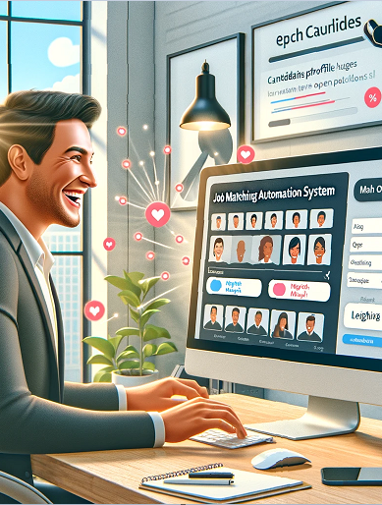
Solution
To address the challenges faced by recruiters in efficiently matching resumes to job descriptions, an advanced automation system for resume matching can be implemented. This system will leverage cutting-edge technologies such as AI, natural language processing, and machine learning to significantly enhance the recruitment process.
Steps: *From previous slides
Setting up and Preparing Data
Developing a Matching Mechanism
Creating Matching Parameters
Continuous Review and Improvements
By implementing this comprehensive automation system for resume matching, recruiters can significantly reduce the time and effort required to identify suitable candidates, improve the quality of hires, and enhance the overall efficiency of the recruitment process.

Slide 9
Example:
Resume Renegade - Resume & Job Matching Assistant
I am a candidate looking for an It manager role
Given your interest in IT manager roles and based on the resume and job descriptions available in the uploaded documents, it appears that there are several potential matches for positions within Wells Fargo. Your background in IT management, particularly with experience in network engineering, helpdesk administration, disaster recovery, and a focus on strategic planning and team leadership, aligns well with several roles. However, your resume highlights a strong emphasis on wellness and fitness coordination, which is a departure from typical IT management roles.
To bridge this gap and align more closely with the available IT-focused positions at Wells Fargo, you might consider emphasizing any IT-related experience or skills that you have, even if they were not the main focus of your previous roles. Additionally, pursuing further certifications or training in IT management, cybersecurity, or specific technologies mentioned in the job descriptions could strengthen your application.
Here are some roles at Wells Fargo that could potentially match your skills and experience, considering you may need to emphasize more of your IT-related competencies:
Infrastructure Engineer (Data Center) - R-303525: This role involves responsibility for designing, building, enhancing, and integrating technology infrastructure. It requires experience with data center operations, including space, power, cooling, and network, which may align with your IT management experience. Emphasizing any direct experience with data center management, network engineering, and infrastructure planning could make you a strong candidate for this position.
Lead Business Systems Consultant- Customer Account Servicing - R-321682: This position focuses on supporting operational readiness and incident, problem, and availability activities, requiring a solid understanding of technology infrastructure and solutions. Highlighting your leadership skills, project management experience, and any specific technology solutions you have implemented could align your background with this role.
Information Security Engineering Senior Manager - Encryption & Key Management Infrastructure - R-337913: Given the emphasis on leadership and information security, this role requires experience with encryption, tokenization, and key management technologies. If you have any experience or training in cybersecurity or information security management, focusing on these aspects could make you a competitive candidate for a senior management position in this domain.
To improve your match for these jobs, consider the following recommendations:
Update your resume to highlight any direct or transferable IT management skills and experiences, focusing on areas relevant to the job descriptions, such as disaster recovery planning, network infrastructure management, and team leadership in technology projects.
Pursue additional certifications or training in areas like cybersecurity, cloud computing, or specific technologies mentioned in the job descriptions (e.g., encryption, data center management).
Tailor your application and cover letter to address the specific requirements and responsibilities of each role, demonstrating how your background and skills make you an ideal candidate for the position.
Lastly, networking with professionals in the IT domain or directly within Wells Fargo could provide valuable insights and potentially open doors to opportunities that align with your career goals in IT management.

Slide 10
Example:
Give me your top 5 resumes that have the keywords IT or LAN
After reviewing the documents, here are the top 5 resumes that prominently feature IT and LAN experience, suitable for roles requiring expertise in these areas:
Resume 1: Information Technology Manager - This candidate has extensive experience in managing IT departments, implementing and evaluating systems infrastructure, and possesses a strong background in network engineering, disaster recovery, and strategic planning .
Resume 2: Information Technology Manager - Highlights include dedicated IT management skills, expertise in analyzing and mitigating risk, boosting performance and productivity, and experience in establishing realistic goals and enforcing deadlines .
Resume 3: Working RF Systems Engineer - While primarily focused on RF engineering, this resume includes experience with network and signal analysis tools, which can be valuable in IT and LAN management roles .
Resume 4: Finance Manager/Operations Manager - This resume details strong analytical skills, problem-solving capabilities, and technical expertise, including technical support and network support, which are critical in IT and LAN environments .
Resume 5: Construction - Although the primary focus is on construction, the candidate has experience with Microsoft Office Applications, including technical and customer service skills that could be transferable to IT and LAN management roles .
These resumes showcase a range of skills and experiences related to IT and LAN management, from direct IT management to engineering roles with relevant technical competencies. Each candidate presents a unique set of skills that could be valuable in roles requiring expertise in IT and LAN environments.

Slide 11
Example:
Review this resume and whether it fits this job description: We are looking for a fitness trainer for our gym. they must be outgoing and have fitness experience
Based on the resume of the Group Fitness Coordinator and the job description for a Fitness Trainer, this candidate appears to be a strong match for the position you're looking to fill. Here’s a review highlighting why they fit:
Resume Highlights:
Professional Summary: The candidate is described as a highly motivated wellness professional, which aligns with the need for an outgoing personality in the job description. Their aim to advance their career in providing community programs and services suggests a passion for fitness and helping others, an essential trait for a fitness trainer.
Experience in Group Fitness Coordination: From 05/2012 to 10/2015, they directed and supervised a Group Fitness Program, including staffing and evaluating over 30 instructors. This experience demonstrates leadership skills and a deep understanding of fitness programs, which would be beneficial in a gym setting.
Developed Educational Seminars and Health Events: The ability to develop and run seminars and health-related events indicates strong communication skills and an ability to engage and motivate individuals towards wellness goals.
Certifications and Skills: The resume mentions certifications in CPR, First Aid, AED, and Les Mills Bodypump, alongside skills in health education, innovative project design, and advanced wellness industry knowledge. These qualifications are directly applicable to a fitness trainer's role, ensuring they can provide safe and effective guidance to gym members.
Job Description Alignment:
Outgoing Personality: The resume reflects an individual who is actively involved in community wellness, suggesting they possess the outgoing personality desired for the role.
Fitness Experience: With extensive experience in group fitness coordination, personal training, and educational program development, the candidate clearly has the required fitness experience.
Additional Considerations:
To further solidify the match, it might be beneficial to know more about the candidate's direct personal training experience and any specializations (e.g., weight training, yoga, pilates) that could complement the gym's offerings.
While the resume strongly suggests suitability for the fitness trainer position, ensuring the candidate's training style and personality fit the gym's culture and member expectations is also important.
Conclusion:
The Group Fitness Coordinator’s resume suggests that they are not only a fit for a Fitness Trainer role but also bring valuable experience and certifications that could enhance a gym's fitness offerings. Their proven track record in fitness program development, team leadership, and health education aligns well with the requirements for an outgoing and experienced fitness trainer.

Slide 12
Example:
I am looking for a senior manager role. Review this resume and highlight strengths. note improvements as well
To assess your fit for a senior manager role, let's review and analyze the resume of the Information Technology Manager from the documents provided, highlighting strengths and areas for improvement.
Strengths:
Leadership and Management Skills: The resume demonstrates strong leadership capabilities, particularly in managing IT departments and teams. Experience in planning, implementing, and evaluating systems infrastructure indicates the ability to oversee complex initiatives and projects.
Technical Expertise: Your expertise spans across network engineering, helpdesk administration, software licensing, disaster recovery, and backup/restore operations. This technical proficiency is crucial for senior management roles in IT or related fields.
Project Management: Experience in overseeing installations, configurations, maintenance, and upgrades of networks, hardware, servers, and peripherals shows competence in project management, an essential skill for senior managers.
Strategic Planning and Analysis: Your ability to execute complex initiatives and meet deadlines in dynamic environments reflects strong strategic planning and analytical skills.
Vendor Relations: Managing licenses, service contracts, and vendor relationships are important aspects of senior management roles, and your resume reflects competence in these areas.
Areas for Improvement:
Quantifiable Achievements: While your resume lists numerous responsibilities, incorporating quantifiable achievements can provide a clearer impact of your contributions. For example, stating specific cost savings, efficiency improvements, or performance metrics achieved under your leadership can be more compelling.
Professional Development: Highlighting recent training, certifications, or continuing education can demonstrate your commitment to staying current with industry trends and technologies, which is important for senior management positions.
Soft Skills: Senior managers often need to possess strong soft skills, including communication, negotiation, and conflict resolution. Providing examples of how you've effectively used these skills in professional settings can enhance your resume.
Strategic Contributions: Expanding on your role in strategic planning, decision-making processes, and contributions to the overall business strategy can help showcase your suitability for senior management roles.
Technology Integration: In today’s rapidly evolving tech landscape, emphasizing experience or familiarity with emerging technologies (cloud computing, AI, cybersecurity measures, etc.) can be beneficial, depending on the specific senior manager role you’re targeting.
Conclusion:
Your resume exhibits a solid foundation in IT management with a blend of technical and leadership skills ideal for a senior manager position. To strengthen your application further, consider quantifying your accomplishments, highlighting recent professional development, and detailing your strategic contributions and soft skills. Tailoring these improvements to align with the specific requirements of the senior manager role you're applying for will make your resume even more compelling.

Slide 13
Resume Renegades
The creation of an automated system for recruiters represents a transformative step forward in the recruitment process. By harnessing the power of artificial intelligence, natural language processing, and machine learning, this system not only simplifies the task of matching resumes to job descriptions but also elevates the efficiency and accuracy of identifying the best candidates. This innovation addresses the critical needs of recruiters, enabling them to navigate the complexities of talent acquisitions with greater ease and effectiveness.
Ultimately, by implementing such an advanced system, we empower our recruiters with a tool that enhances their capabilities, streamlines the hiring process, and ensures that our organization remains competitive in securing top talent. This solution is not just about making recruiters’ lives easier; it’s about revolutionizing the way we approach recruitment to foster a more dynamic, skilled and satisfied workforce.

Slide 14
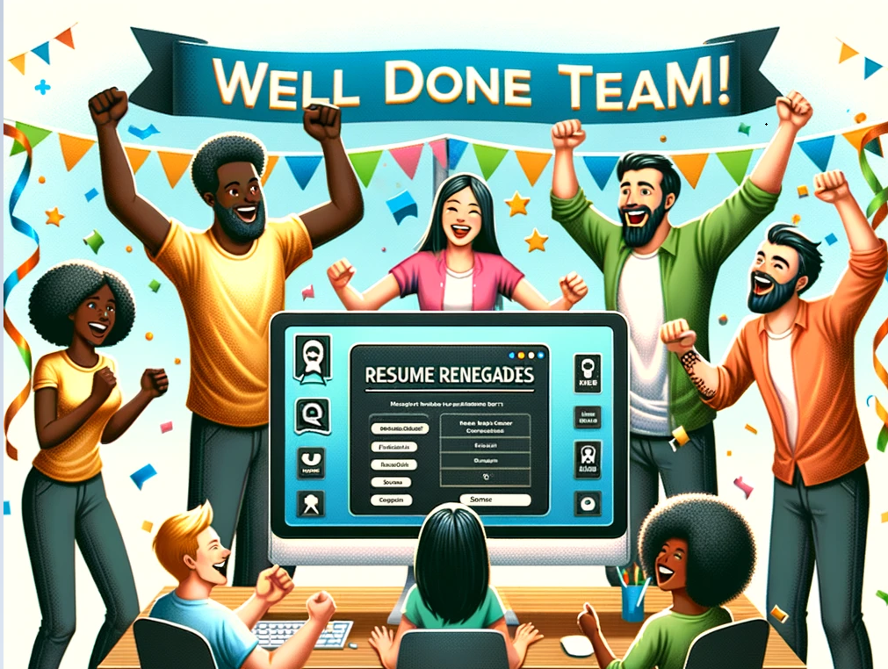
Thank You
Shelby Martin
Amudala Olawore
Isha Goyal
Ekenechukwu Nwannunu
Geanie Asante

